Slide 1
Numerical Computing Lec 8
By
Asst. Prof. Syed Shujaat Hussain.
Interpolation Review
&
Numerical Differentiation

Slide 2
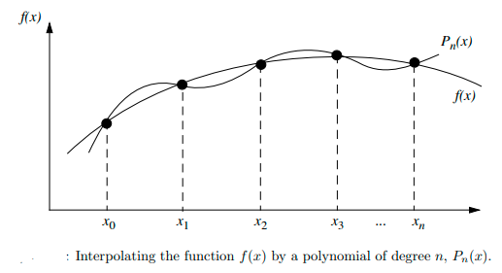
Polynomial Interpolation
Let f(x) be given at the selected sample of (n + 1) points: x0 < x1 < · · · < xn,
i.e., we have (n+1) pairs (xi, fi), i = 0, 1, 2, . . ., n.
The objective now is to find the lowest degree polynomial that passes through this selected sample of points.

Slide 3
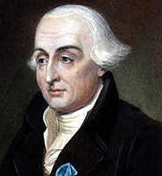
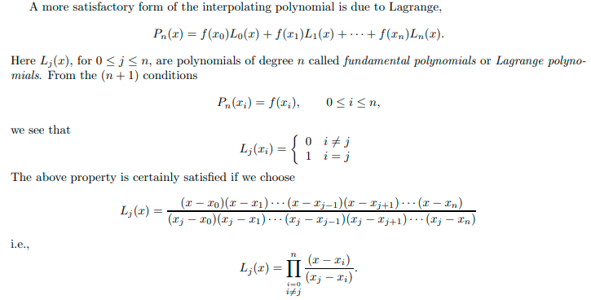
Lagrange Approach (1736-1813)

Slide 4
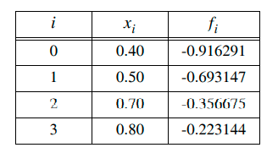
Class Activity Q: Find the Lagrange Polynomial for the following Q: Find g(0.6)

Slide 5
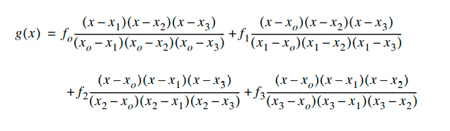
Solution

Slide 6
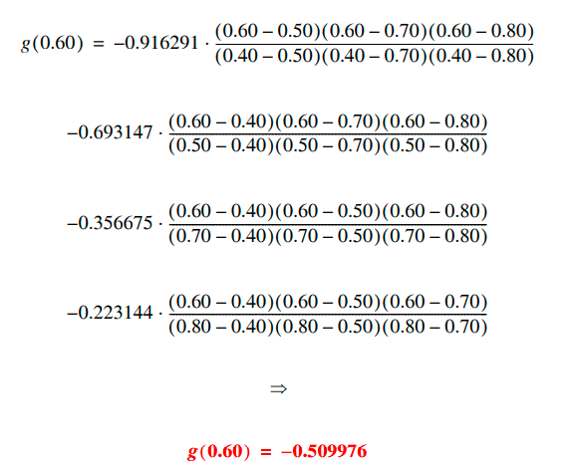
Solution

Slide 7

Class Activity
Q
a) Construct a Lagrange polynomial .
b) Calculate P₃(π/4)

Slide 8
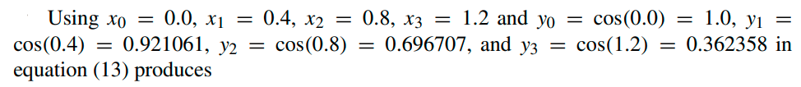
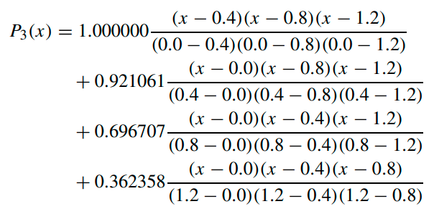
Solution

Slide 9

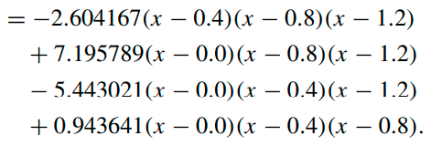
Solution

Slide 10
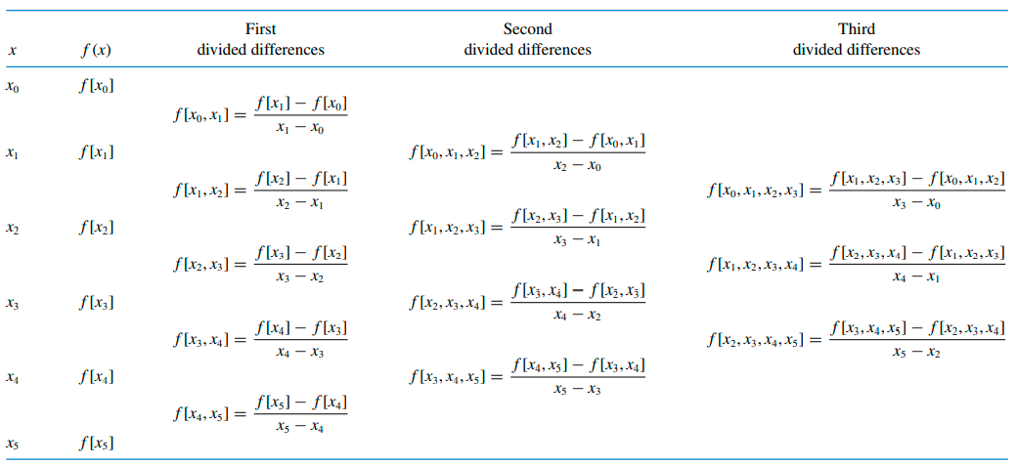
Divided Difference

Slide 11
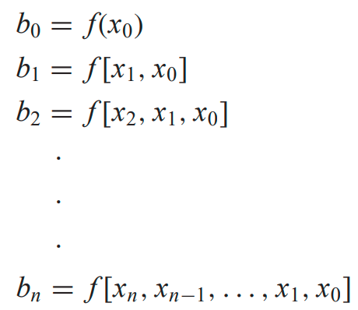

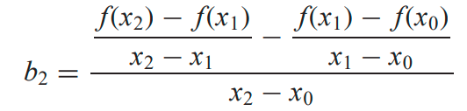
Newton’s Interpolating Polynomial
The nth-order Newton’s polynomial is
For an nth-order polynomial, n + 1 data points are required
Where
for example

Slide 12
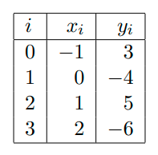
Class Activity Q: Use Newton interpolation to find the unique polynomial P₃(x), of degree 3 or less, that agrees with the following data:

Slide 13
Divided Difference Table
X | Y | DD1 | DD2 | DD3
-1 | 3
 |  | -7
0 | -4 |  | 8
 |  | 9 |  | -6
1 | 5 |  | -10
 |  | -11
2 | -6

Slide 14
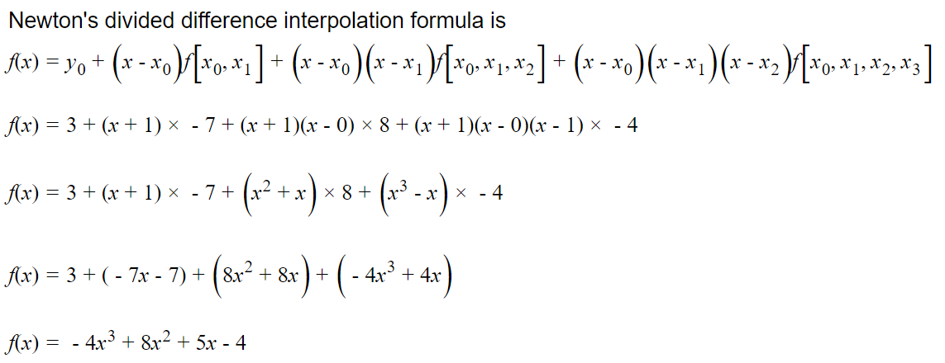
Newton’s Polynomial

Slide 15
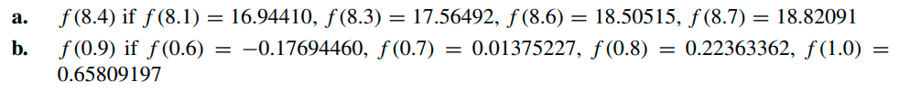
Test your ability!
Q 1 Construct a Newton’s interpolation polynomial for the
following data provided. Then approximate the it for
the given value.

Slide 16
Q1: Divided Difference Table
X | Y | DD1 | DD2 | DD3
8.1 | 16.9441
 |  | 3.1041
8.3 | 17.56492 |  | 0.06
 |  | 3.1341 |  | -0.00208
8.6 | 18.50515 |  | 0.05875
 |  | 3.1576
8.7 | 18.82091

Slide 17
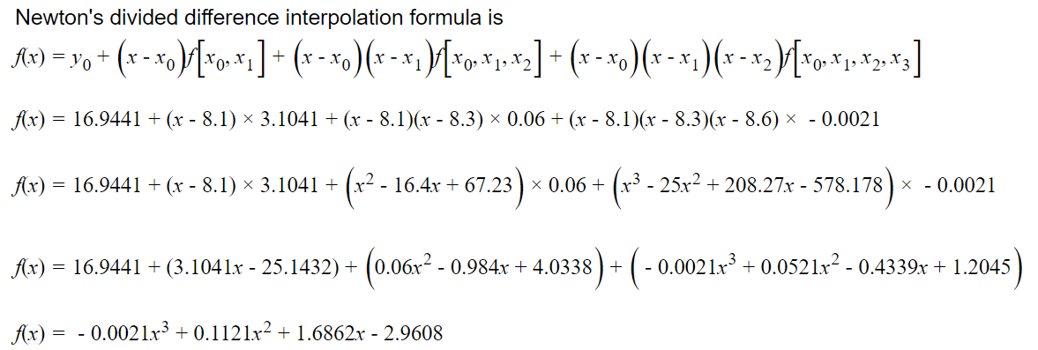
Newton’s Interpolation Polynomial

Slide 18

Newton’s Interpolation Polynomial

Slide 19
Q2: Divided Difference Table
X | Y | DD1 | DD2 | DD3
0.6 | -0.1769446
 |  | 1.9069687
0.7 | 0.01375227 |  | 0.959224
 |  | 2.0988135 |  | -1.78574125
0.8 | 0.22363362 |  | 0.2449275
 |  | 2.17229175
1 | 0.65809197

Slide 20
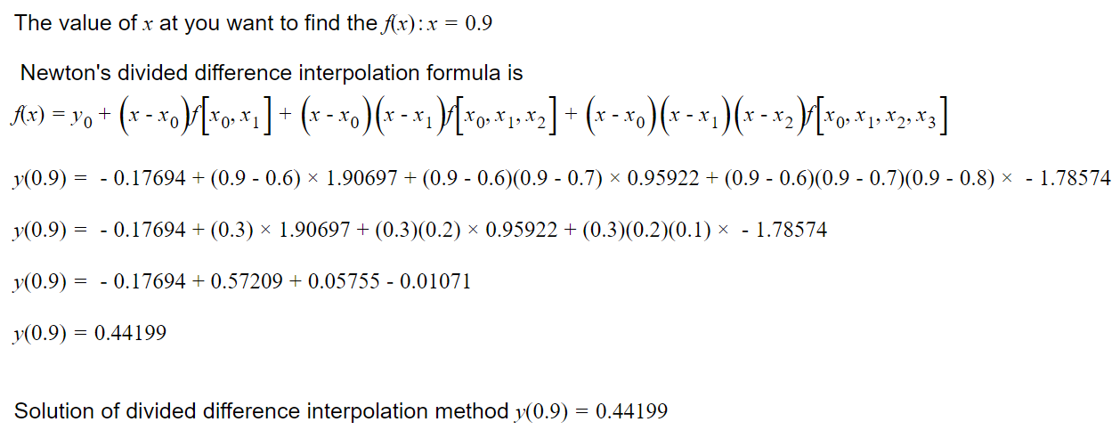
Q2: Newton’s Polynomial

Slide 21
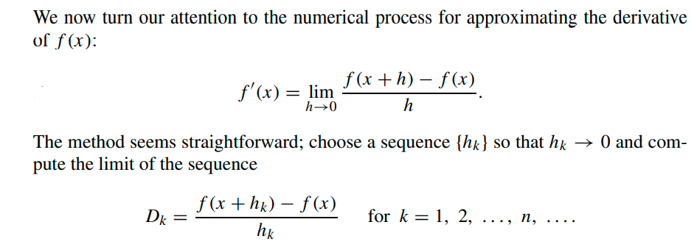
Numerical Differentiation

Slide 22
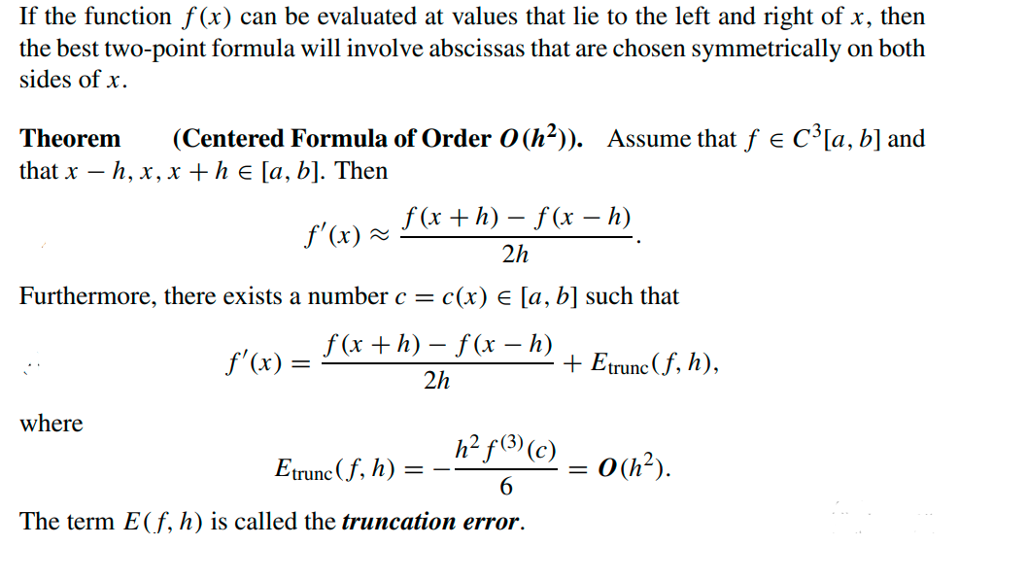
Central-Difference Formulas

Slide 23
Example
Let f (x) = cos(x).
(a) Use Central difference formulas with step sizes h = 0.1, 0.01, 0.001, and
0.0001, and calculate approximations for f’(0.8). Carry nine decimal
places in all the calculations.
(b) Compare with the true value f‘(0.8) = − sin(0.8).
Solution : (a) Using formula (3) with h = 0.01, we get
(b) The error in approximation formulas turns out to be −0.000011941

Slide 24
Class Activity
Q: Let f (x) = sin(x), where x is measured in radians.
(a) Calculate approximations to f’(0.8) using central difference formula
with h = 0.1, h = 0.01, and h = 0.001.
( Carry eight or nine decimal places.)
(b) Compare with the value f’(0.8) = cos(0.8).

Slide 25
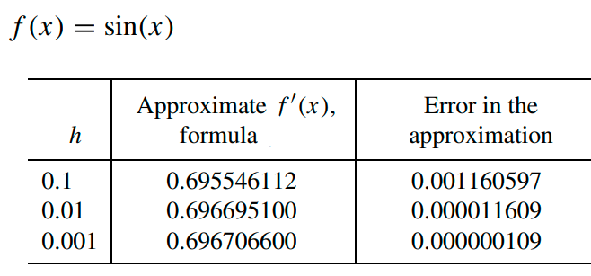
Solution (Approximating the Derivative)

Slide 26


Class Activity
Q: Compute using “central difference” formula
Let f (x) = x³ and find approximations for f’(2).
(a) Use formula with h = 0.05
(b) Compute the truncation error o(h²)

Slide 27
Solution

Slide 28
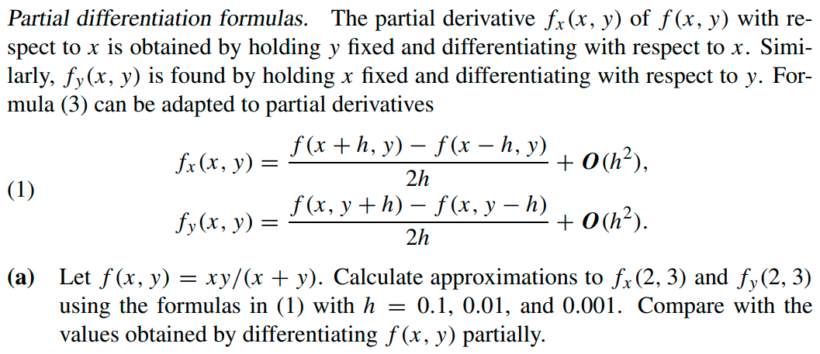
Test Your ability !
Q:

Slide 29
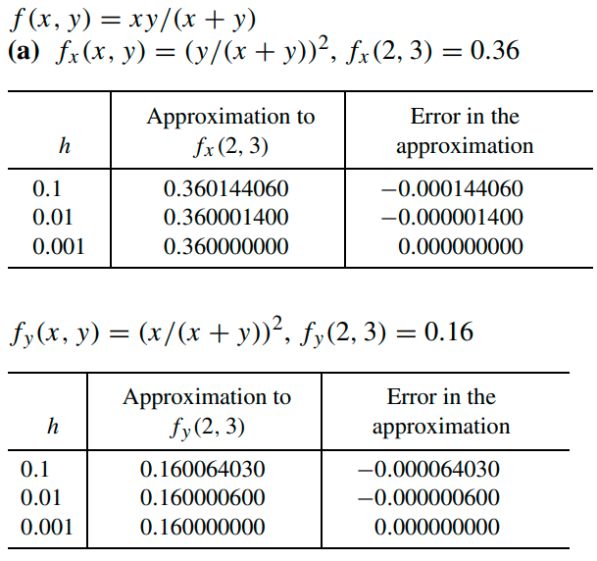

Solution

Slide 30
Solution

Slide 31
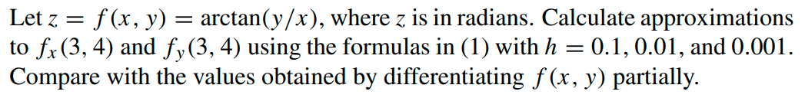
Test your ability!
Q.

Slide 32
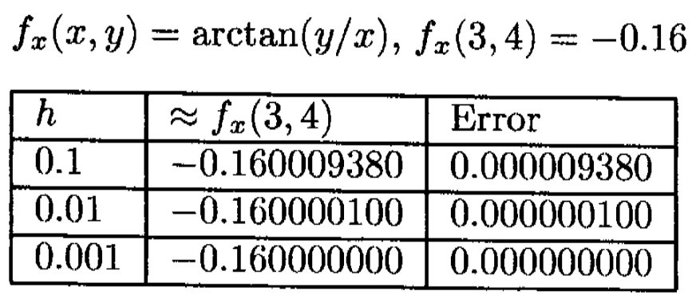
Solution

Slide 33
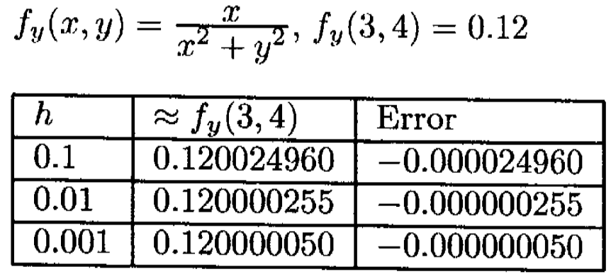
Solution

